Slide 1

Client / Server System
Network
Network
Server process
Provides Services
Client process
Clients request services from different server processes.
Files,
printing
fax,
multimedia communications
Chat
Pay Bills
Email
Mobile Apps

Slide 2



Clients can request services from several servers and servers can provide services for more than one clients.
Client
host
Client
host
Server
host

Slide 3
“I want to
collaborate
with my
colleague”
“I want to access
some information”
Client
Server
Peer-to-peer
Client/server
Notes:
Copyright 1999, University of California

Slide 4

Email application
Server
Client
Client
Email client sends message to server
Later, recipient’s email client retrieves message from server
Message is stored on POP server

Slide 5
Chat application
Server
Client
Client
Chat server aggregates typing from all users and sends to all clients
Other user’s clients display aggregated typing from chat server
Chat clients send user’s typing to server

Slide 6
How components interact?
Client
process
SQL
SQL
Client
process
Communications
middleware
network
Database
server
Data
Data
Clients process sends SQL request through communications middleware.
Middleware routes SQL request to database server process.
Database server process receives request, validates it, and executes it.

Slide 7
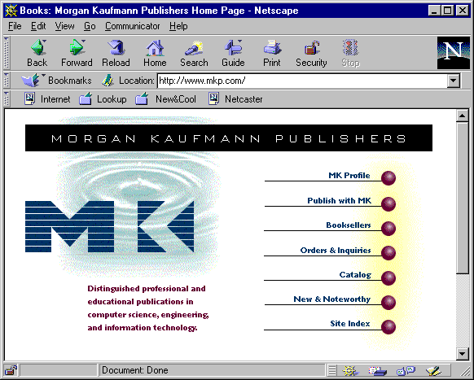

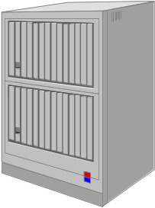
Client
Host architecture
Web
browser
Web
server
Common
gateway
interchange
Application logic
Databases and DBMS
Application partition

Slide 8
Network Protocols
• Transmission Control Protocol/ Internet Protocol (TCP/IP)
The official communications protocol of the Internet. TCP/IP is the main communications protocol used by Unix systems, is supported by most operating systems at the midrange and personal computer levels.
• Internet Packet Exchange/Sequenced Packet Exchange (IPX/SPX)
Communications protocol developed by Novell. IPX/SPX is supported by the majority of client/server network applications and by all PC operating systems.

Slide 9
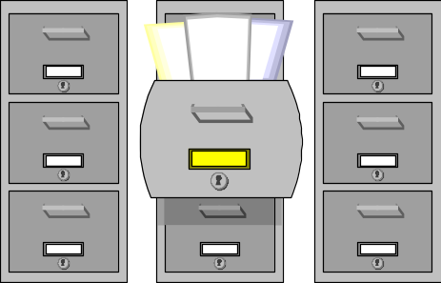

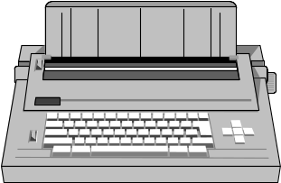



Departments
Enterprise-to-enterprise
Commerce
Consumer
Enterprise

Slide 10


software4u.com
Customers
Customer-service
department
Technical-support
department
Consumer
Enterprise

Slide 11
Consumer
application
Enterprise
application
Web
browser
Web
browser
Web
browser
Web server
Web server
Web server
Customer care
Customer logic
Agent logic
Technician logic
Databases
Customer
audit
Software
documentation
Problem
knowledge
base

Slide 12
Customers
Agents
Technicians
Customer logic
Agent logic
Technician logic
Databases
Accounts
Products
Orders

Slide 13

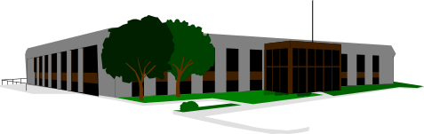

Financial institution
Book distribution
centers
Customers
books4u.com
Consumer
Enterprise
Inter-enterprise

Slide 14
Clients
Acquirer
bank
Customer logic
Fullfillment logic
Databases
Book
distributors
Customers
Merchandise
Orders

Slide 15



Information providers
Customers
Stock market
stocks4u.com
Consumer
Enterprise
Inter-enterprise

Slide 16
Clients
Information
providers
Customer logic
Trading logic
Databases
Financial
markets
Accounts
Products
Orders

Slide 17

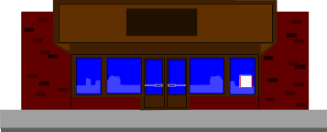

Financial institution
Customers
flowers4u.com
Local florists
Consumer
Enterprise
Inter-enterprise

